Slide 1

Feature selection
on large and sparse datasets
Leon Hvastja, Amadej Pavšič
Advisors: Jure Demšar, Blaž Mramor, Blaž Škrlj

Slide 2

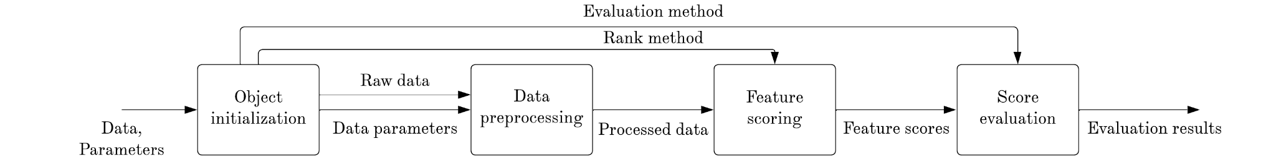
Problem & dataset
Outbrain, web recommendation platform
Sparsity, high cardinality, uninformative features
Efficient feature selection approach
Ranking & evaluation pipeline
Notes:
The problem was defined by Outbrain, a web recommendation platform.
IN this domain of work, it is very common to encounter large and sparse datasets, with some other challenging characteristics, such as high cardinality features or even completely uninformative features.
We were given such a dataset and our task was to find an efficient feature selection approach, to highlight the most important features and subsequently reduce the number of features that Outbrain uses later in the workflow to build complex prediction models.
To explore various feature selection methods, we have built ranking and evaluation pipeline, the flowchart of which you can see on the slide. With this pipeline, we aggregated the whole process of data preprocessing, feature ranking and evaluation, so we could easily and efficiently test numerous algorithms with different subsampling and other parameters.

Slide 3
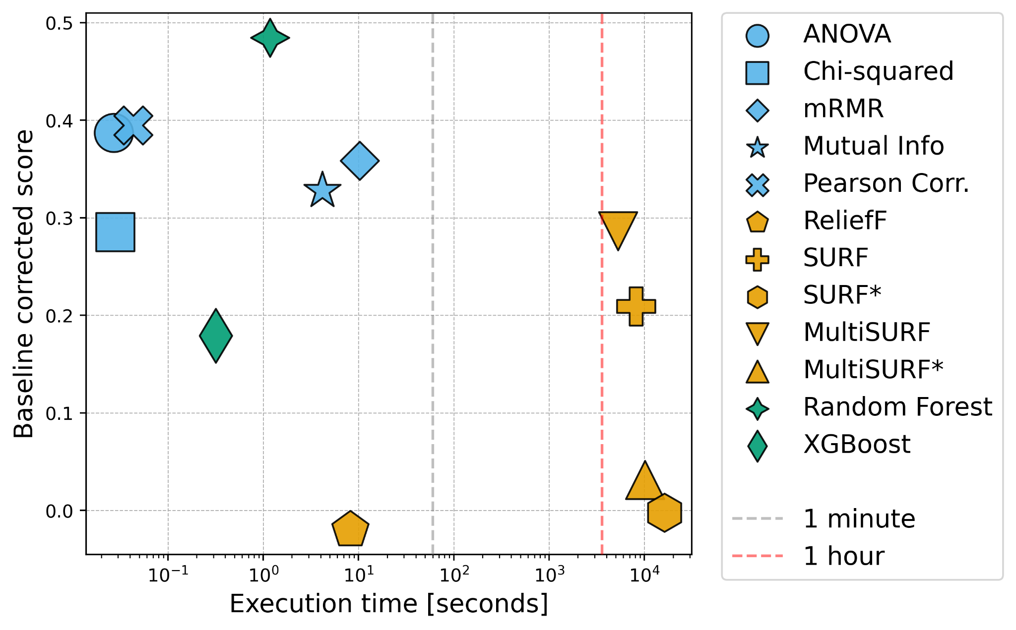
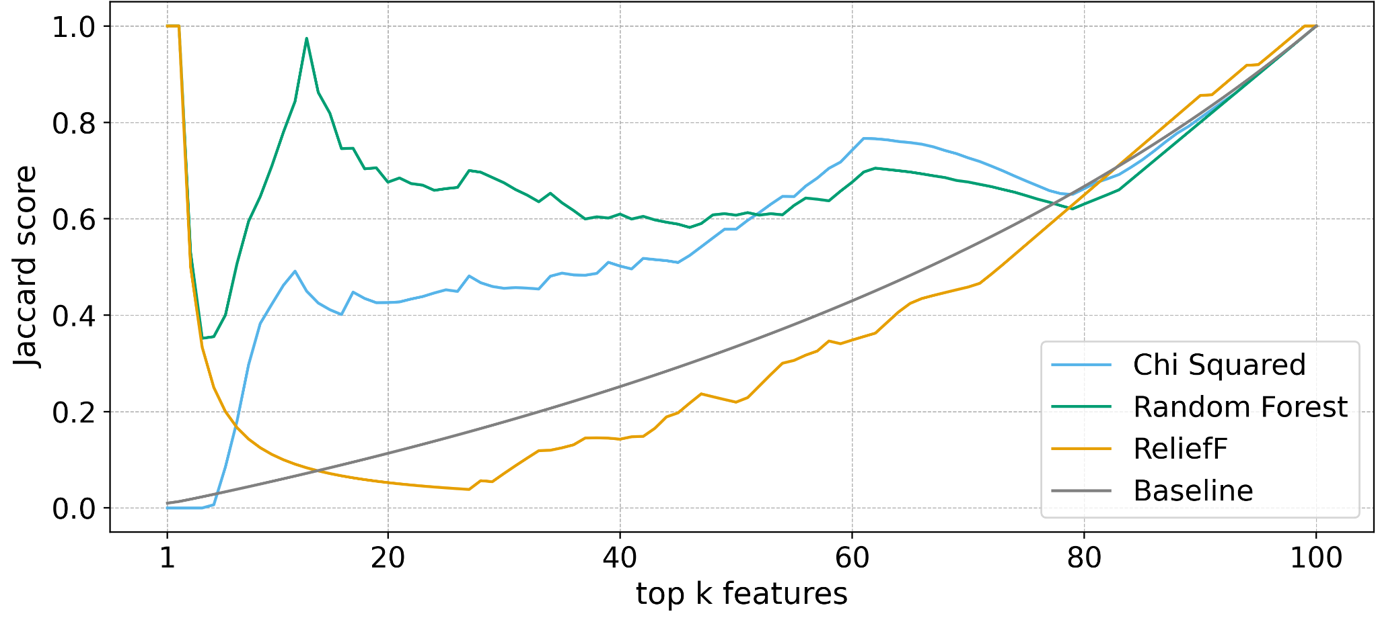
Algorithms
Filter and wrapper methods
Using statistical properties
Relief based approaches
Baseline corrected score
First eliminations

Slide 4
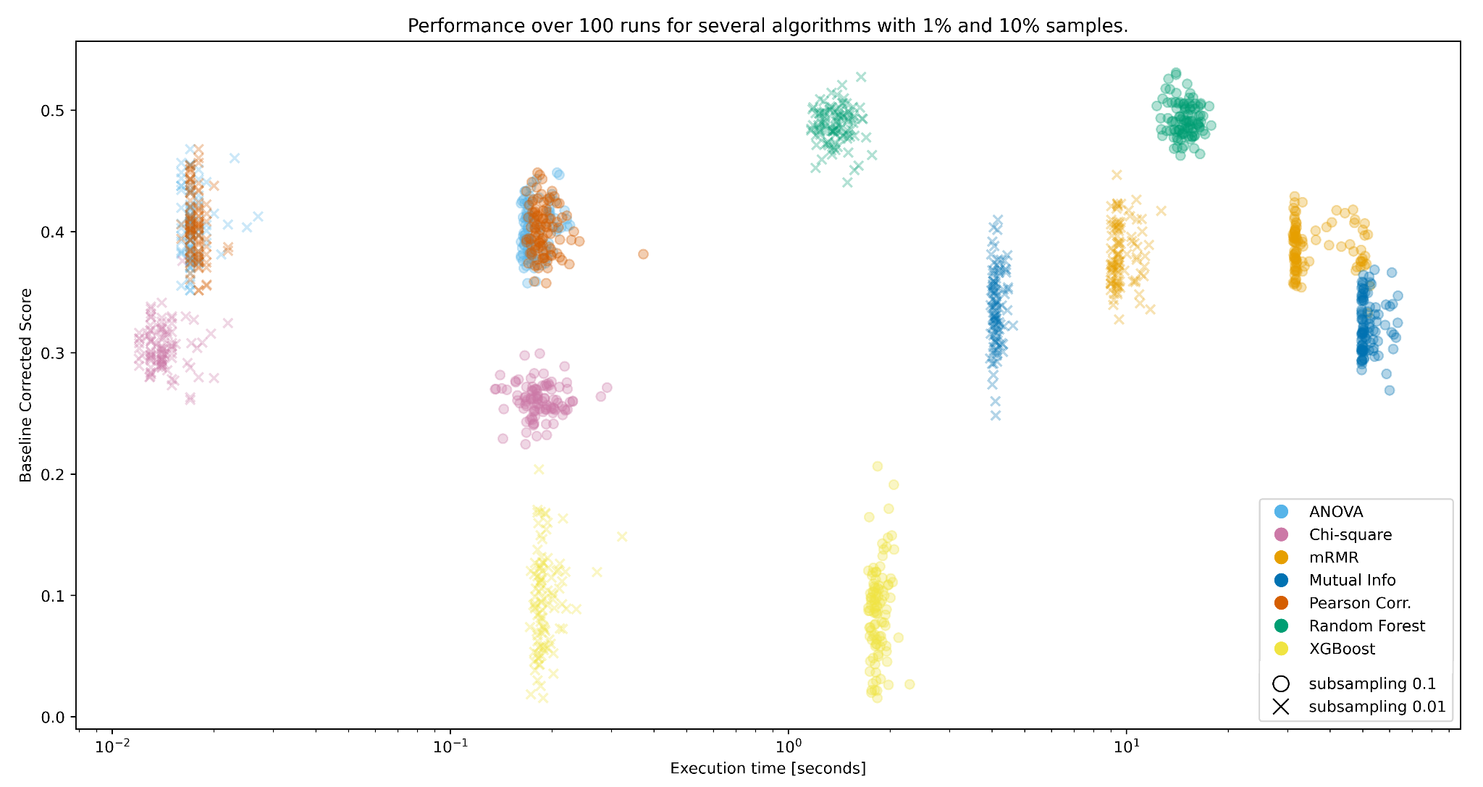

Slide 5
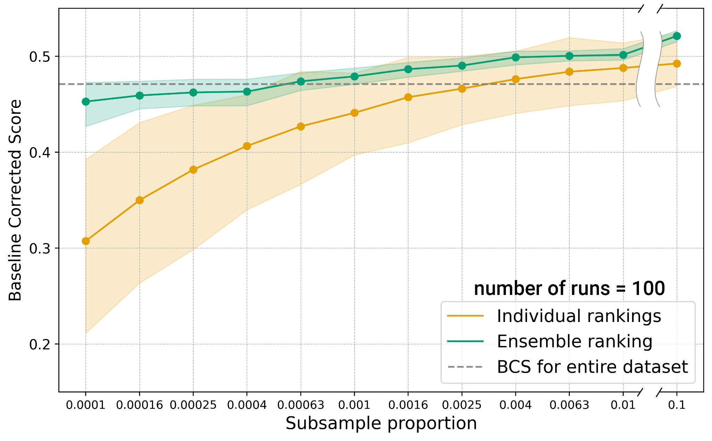
RF performance & ensemble
Subsampling optimization
Ensemble approach
Borda count voting system
Performance & uncertainty
Feature | Run 1 | Run 2 | Run 3 | Borda | Ensemble
A | 1 | 2 | 1 | 4 | 1
B | 2 | 1 | 3 | 6 | 2
C | 3 | 3 | 2 | 8 | 3
Notes:
So based on the results we have chosen random forest to do more detailed analysis on.
Our next task was to optimize subsampling proportion. So we were interested in how little data do we need to still achieve a score comparable to the one on the entire dataset.
On the plot you can see scores of 100 individual rankings for each subsample, presented with the orange line as the mean baseline corrected score, and the shaded area which represents uncertainty.
And here we can observe that with 0.25% of data we get to approximately the same score as on the entire dataset
Then we have also tried an ensemble approach, specifically with Borda count voting system, where feature rankings are obtained as a sum of individual run votes, as presented on a simple example in the table.
Ensemble ranking scores are shown on the figure as the green line, here we used the same 100 runs bootstrapped to get the estimated uncertainty of the ensemble rankings. We can immediately observe much higher average performance than the individual rankings, and notably less uncertainty for all subsamples.
And what’s important to note is that with ensemble ranking we can have even 100 times less data than individual ranking to get to the same performance, and that performance gain is even larger on smaller subsamples.

Slide 6
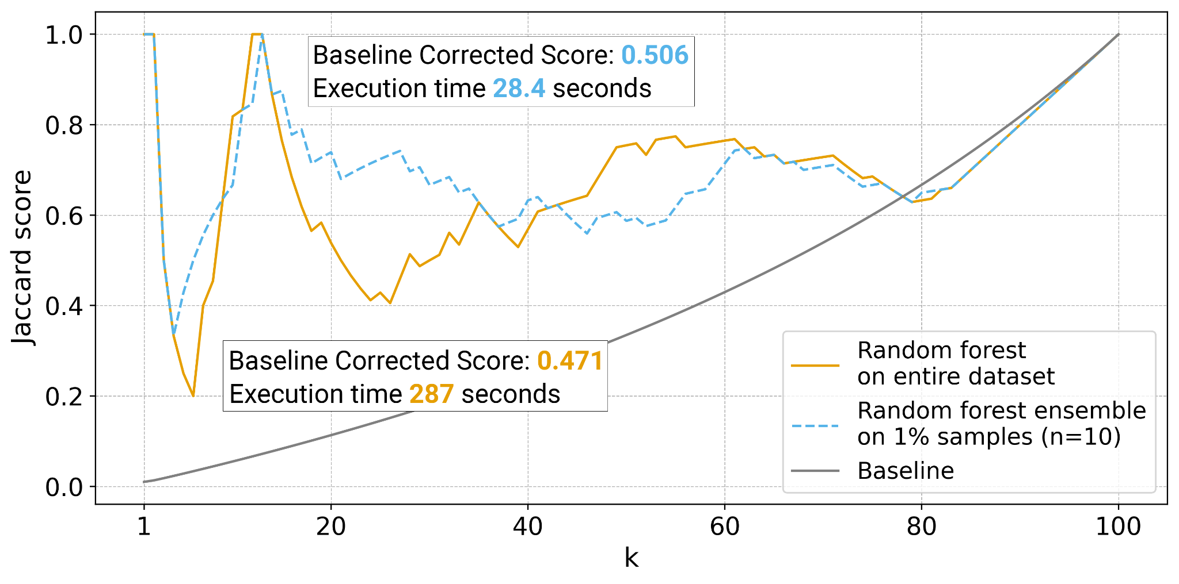
Conclusions
Better scores
Faster execution
Less data
Smaller uncertainty

